Slide 1
EPAR Portfolio Basic Information Scraper
portfolio_scraper.R

Slide 2
Summary
Purpose: This script extracts basic grant information from Gates Foundation grant Proposal Narratives, a template for which is publicly available here:
https://www.gatesfoundation.org/~/media/GFO/How-We-Work/RFP/Polio-Lessons-RFP_Proposal-Narrative.docx?la=en
Input(s): 1) Folder of Proposal Narratives (each in .docx format) and 2) .csv of country names and the regions they fall into (pre- provided, don’t need to create)
Output(s): Single spreadsheet of scraped basic grant information where each row or “observation” is a Proposal Narrative
Benefit(s): Saves researchers hours of coding basic information from grant documents, about 5 minutes for every 10 documents.

Slide 3
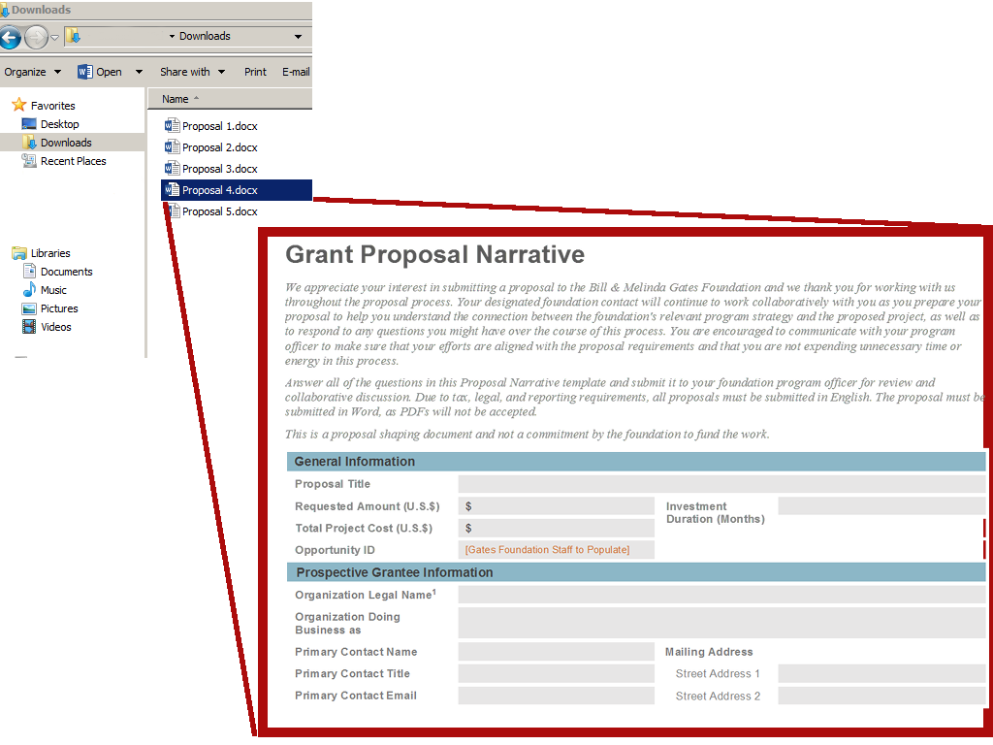
Example Input #1

Slide 4
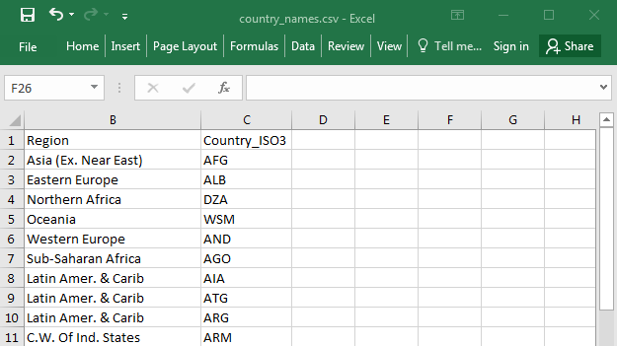
Example Input #2

Slide 5
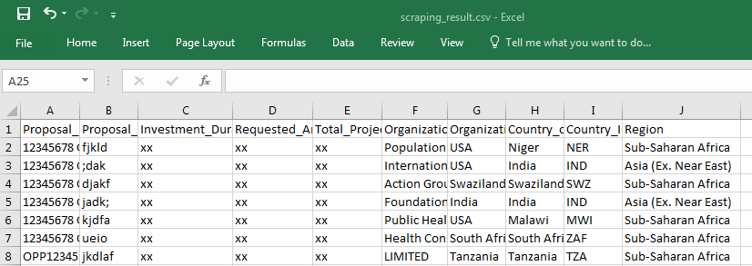
Example Output
Fields Scraped:
Proposal File Name
Proposal Title
Investment Duration
Requested Amount
Total Project Cost
Organization Legal Name
Organization Country
Country of Intervention
Region

Slide 6
Tips on Providing Paths
This script asks for two paths:
Path to your directory of proposals
I.e. the folder where your .docx proposals are
Path to your working directory
I.e. the folder where your spreadsheet should be output
Paths are provided in a string format, inside “ ” marks
E.g. "R:/Project/EPAR/Working Files/372”
Note, your .csv of country names and the regions they fall into should be in this folder too
Best way to get the path correct is to type “getwd()” in the console, copy the front half of the output, and change the second half based off the files you’d like to locate.

Slide 7
Evans School Policy Analysis & Research Group (EPAR)
Professor C. Leigh Anderson, Principal Investigator
Professor Travis Reynolds, co-Principal Investigator
EPAR uses an innovative student-faculty team model to provide rigorous, applied research and analysis to international development stakeholders. Established in 2008, the EPAR model has since been emulated by other UW schools and programs to further enrich the international development community and enhance student learning.
Please direct comments or questions about this research to EPAR’s Tools Development Team: Rohit Gupta (rohit.epar@gmail.com), Muel Skiel (skiel.epar@gmail.com), and Namrata Kolla (namrata.epar@gmail.com)

